Slide 1
GS1 in Europe insights survey 2020
Main highlights – 2019 data

Slide 2
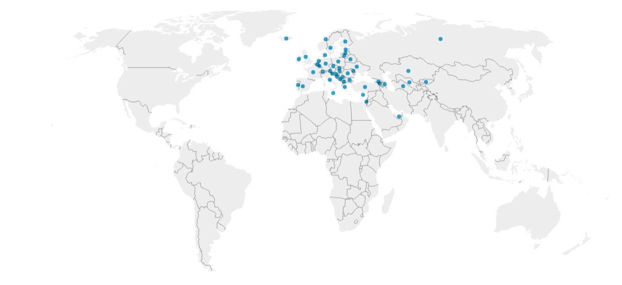
The community of GS1 in Europe*
MOs
Member
companies
Value-added
Services
Financial
strength
Employees
49
186.8 Mln
468.568
1.913
22.5%
* 2019 Y

Slide 3
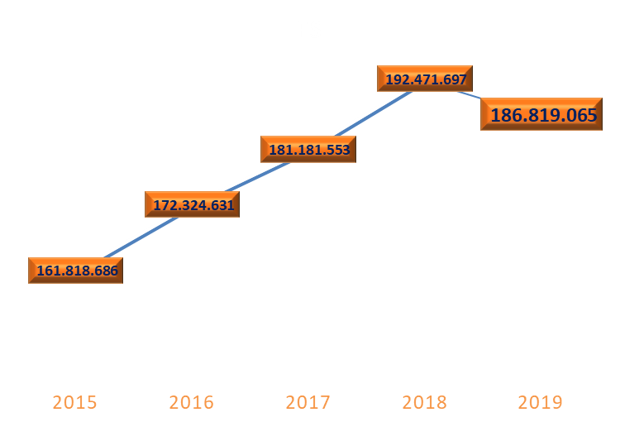
Financial strength
In 2019 respect 2018 there is a decrement of 2.9% in the FS (5.6 Mln less)
In 5 Ys the FS has grown of 15.4% (25 Mln more)
+6.2%
+5.1%
-2.9%
-5.6 Mln
Trend 2019 vs 2018
Trend +6.5%
+15.4%
+25 Mln
Trend 2019 vs 2015

Slide 4
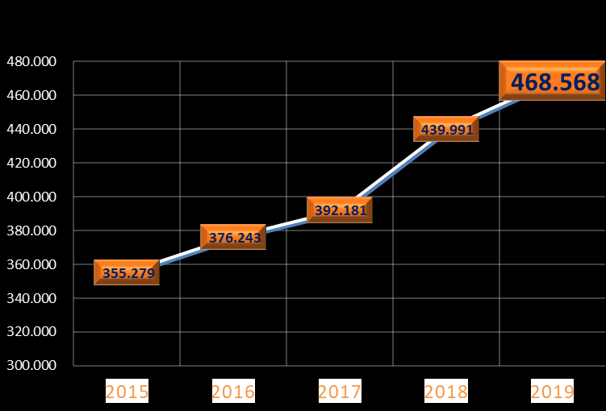
Member companies
In the last year the Member companies have increased of 6.5% (28.577 companies more)
In 5 Ys theMember companies have grown of 31.9% (113.289 more)
+6.5%
+12.2%
+28.577
+4.2%
Trend 2019 vs 2018
+5.9%
+31.9%
+113.289
Trend 2019 vs 2015

Slide 5
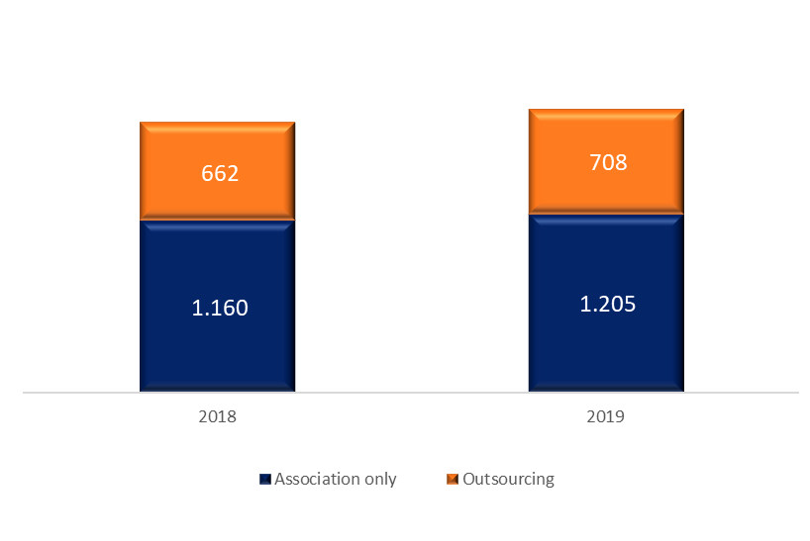
Employees
In 2019 there are 1.913 employees, 5.0% more than in 2018
Trend 2019 vs 2018
+5.0%
1.822
1.913
+6.9%
36%
37%
+3.9%
64%
63%

Slide 6
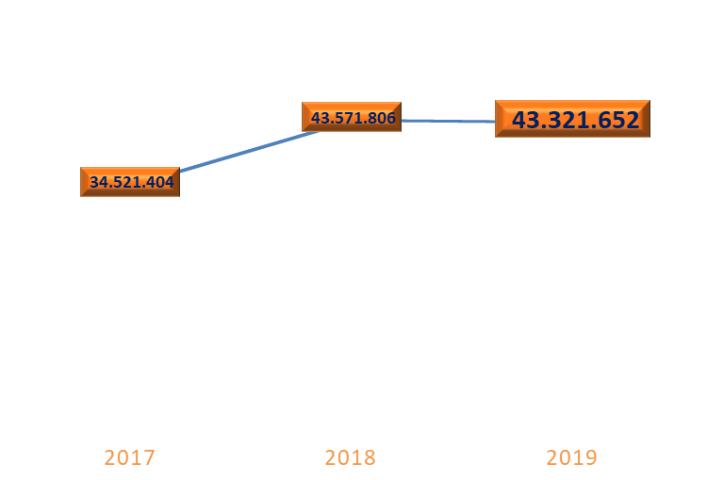
Value Added Services
In 2019 the VAS share is stable: 22.5% of the FS comes from VAS
How many MOS????
+26,2%
-0.1%
Trend 2019 vs 2018
22.5%
VAS % share
19.1%
22.6%

Slide 7
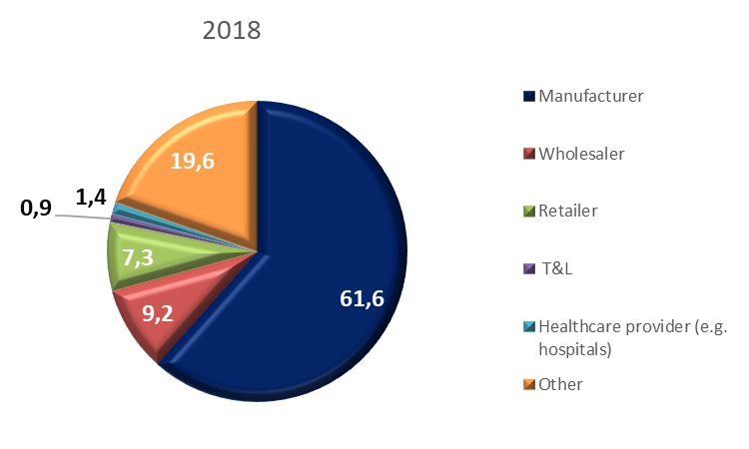
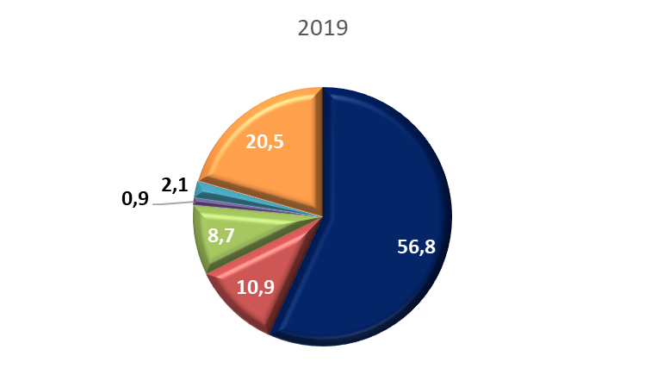
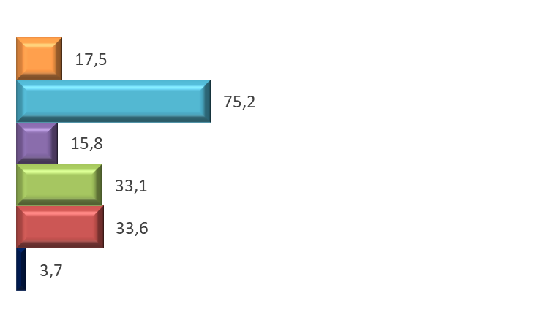
Business type *
Our member base is composed at 56.8% of manufacturers. 10.9 are wholesalers and 8.7 retailers.
Trend 2019 vs 2018
* Sample of 34 MOs that represents 68% of the total member companies

Slide 8
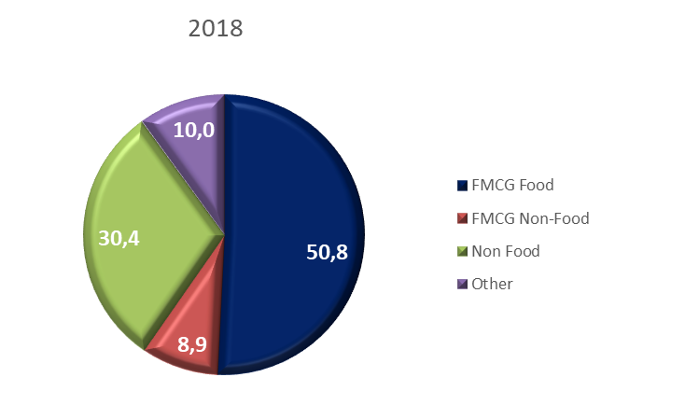
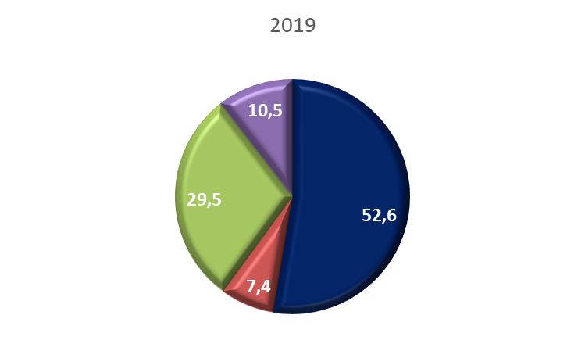
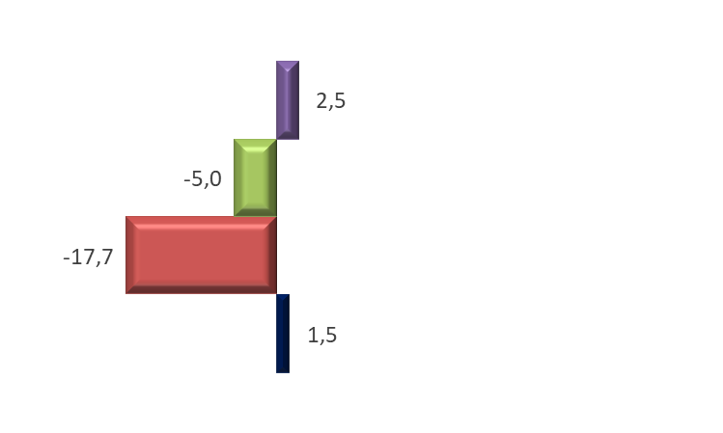
Manufacturers by Sectors*
The 60% of our manufacturers operate in the FMCG market
About 30% in the Non Food market
Trend 2019 vs 2018
* Sample of 27 MOs that represents 56% of the total member companies

Slide 9
The community of GS1 in Europe: summary last Y (2019) - trend (short 1 Y and long 5Ys)
Financial
strength
MOs
Employees
2019 vs 2018
2019 vs 2018
-2.9%
-5.6 Mln
49
+2 MOs
2019 vs 2018
186.8
Mln
1.913
+5.0%
2019 vs 2015
+15.4%
+25Mln
Member
companies
Value-added
Services
2019 vs 2018
60% FMCG
30% Non Food
56.8% Manufacturer
+6.5%
+28.577
2019 vs 2018
468.568
10.9% Whalesaler
22.5%
2019 vs 2015
-0.1%
+31.9%
+113.289
8.7% Retailer

